Slide 1

Metrology

Slide 2
Electrical Pre-Lab
https://www.overleaf.com/read/mkfdycznthxz#02e935
review
copy this project for your own prelab—use as a template for your own report
create 3 empty projects (per group) for your 3 lab reports

Slide 3
Metrology
What is Metrology?
The science of measurement, embracing both experimental and theoretical determinations at any level of uncertainty in any field of science and technology -International Bureau of Weights and Measures (BIPM)

Slide 4
Measurements From Space
What do we measure?
How/what kind of measurements?
Analog Digital

Slide 5
Sequence of Events
Step | Conversion | A/D
Real World
ADC | A/D
Computer
Radio | D/A
Photons
Radio | A/D
Computer
DAC | D/A
Analysis

Slide 6
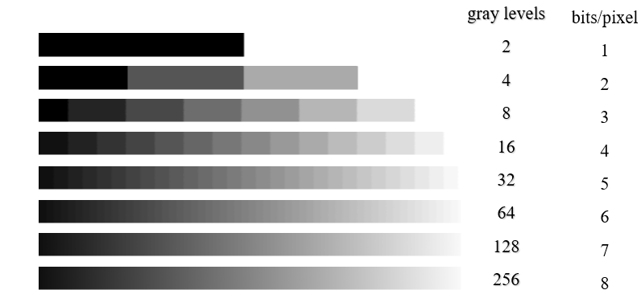
Quantization/Discretization

Slide 7
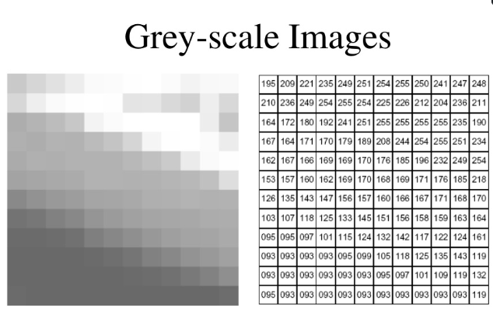

Slide 8
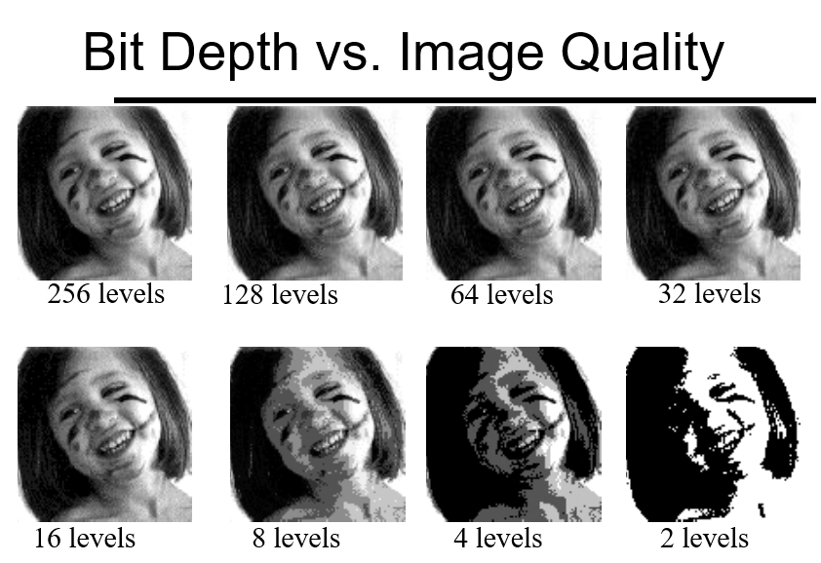

Slide 9
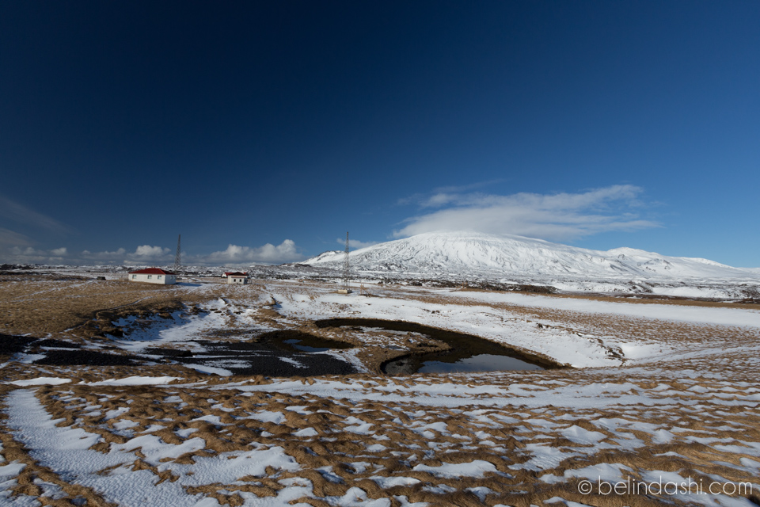
Notes:
differential polarization of sunny sky
circ polarizing filter on wide angle lens
uninspiring subject
fix: photoshop

Slide 10
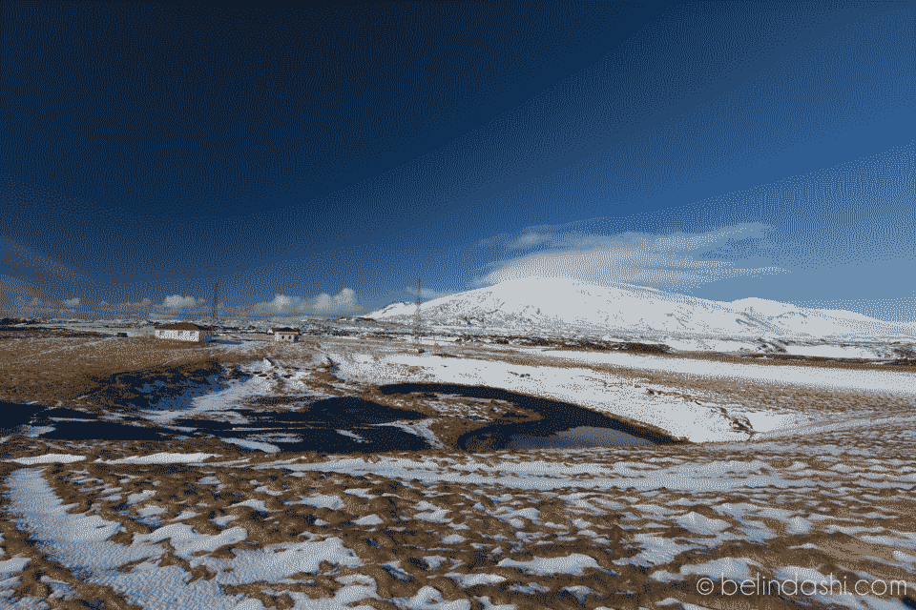
Notes:
banding
often see on big screen TVs with DVDs/streaming content
insufficient color depth (this photo has 4-bit color—how many colors is that?)
fix: Dolby color/HDR/10-bit color

Slide 11
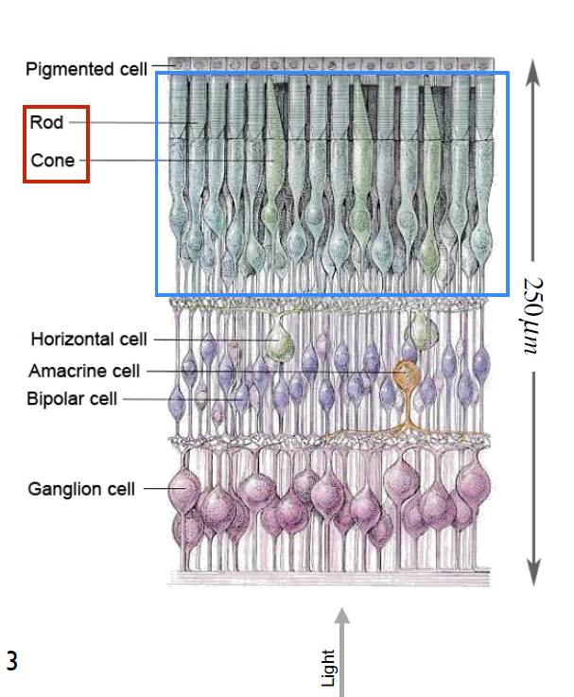
Human Eye

Slide 12
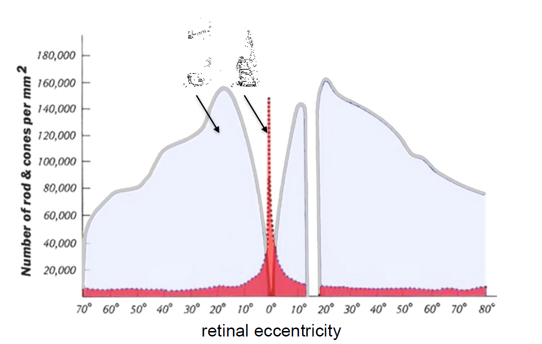

Slide 13
Example:
Spacecraft fuel level
Pressure?
Temperature?
Contact Sensor?

Slide 14
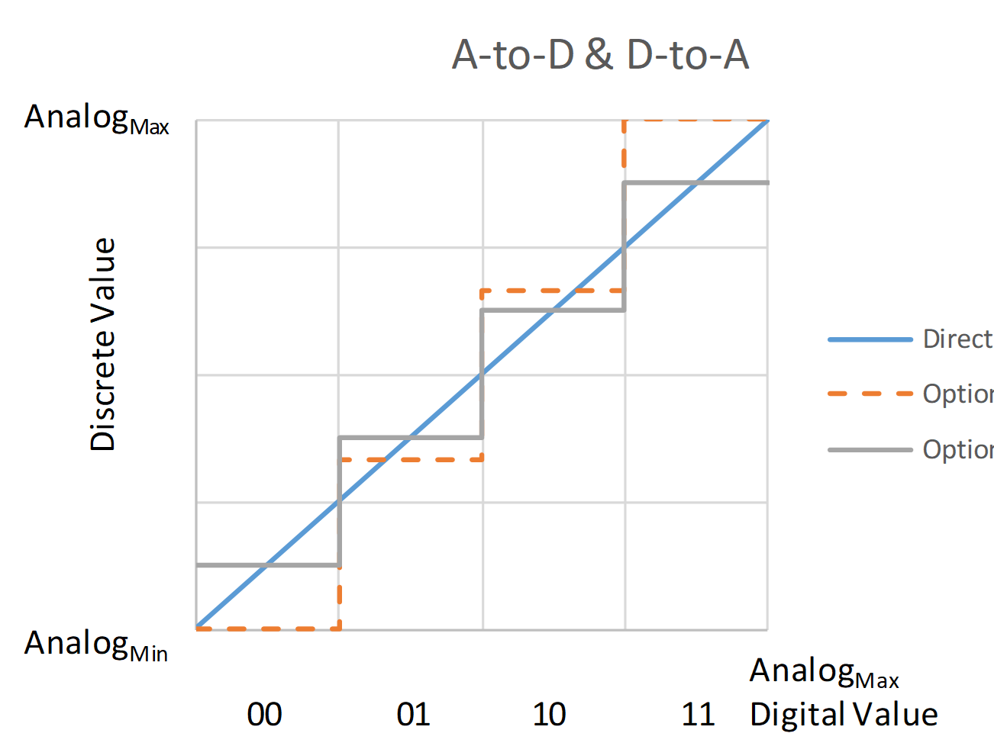
How many bits in this example?
Notes:
2 bits/4 levels

Slide 15
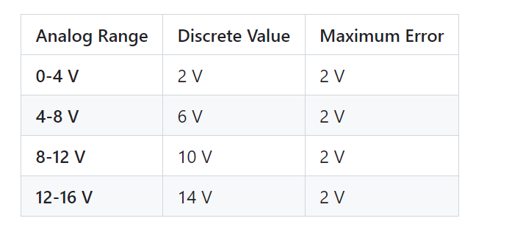
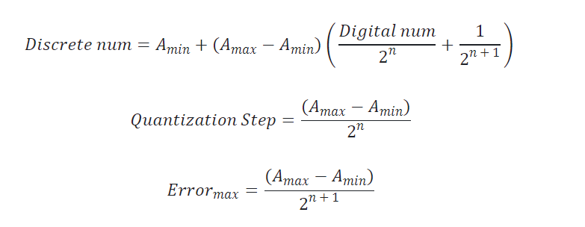
What can we Quantize?
Notes:
voltage (you will do this today)
brightness
current?
acceleration
force
loudness/sound pressure

Slide 16
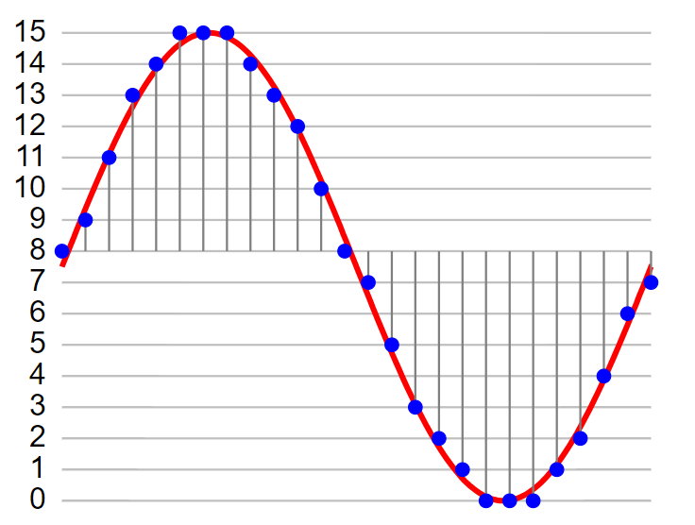
Audio Signal

Slide 17
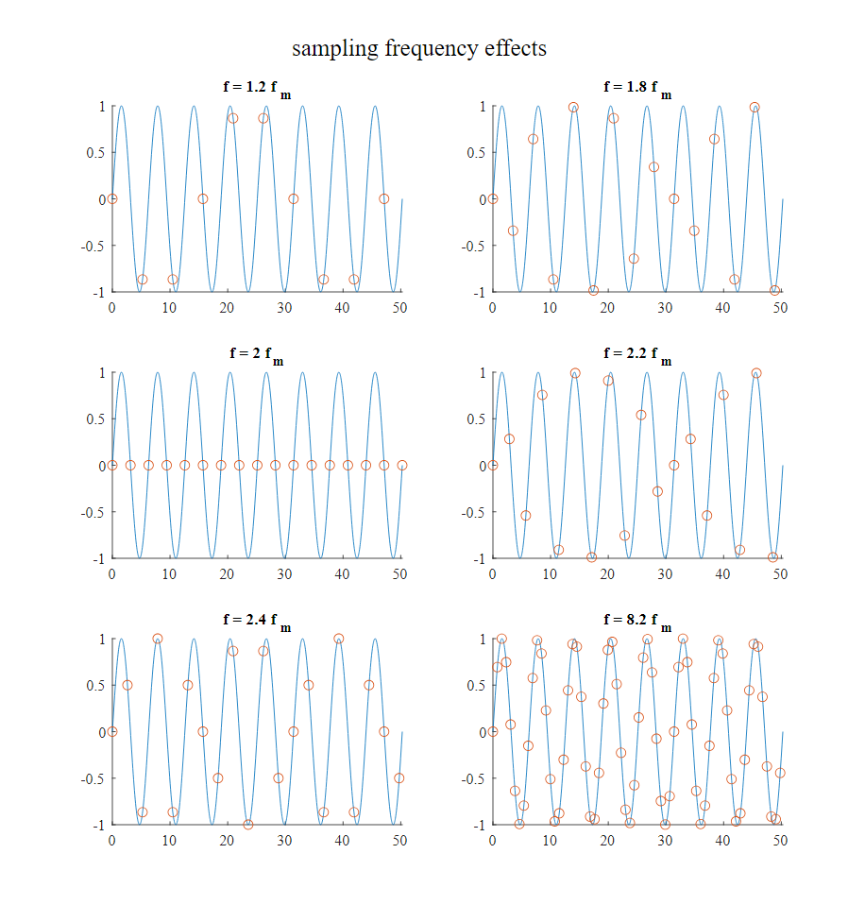
Sampling Frequencies
Nyquistt

Slide 18
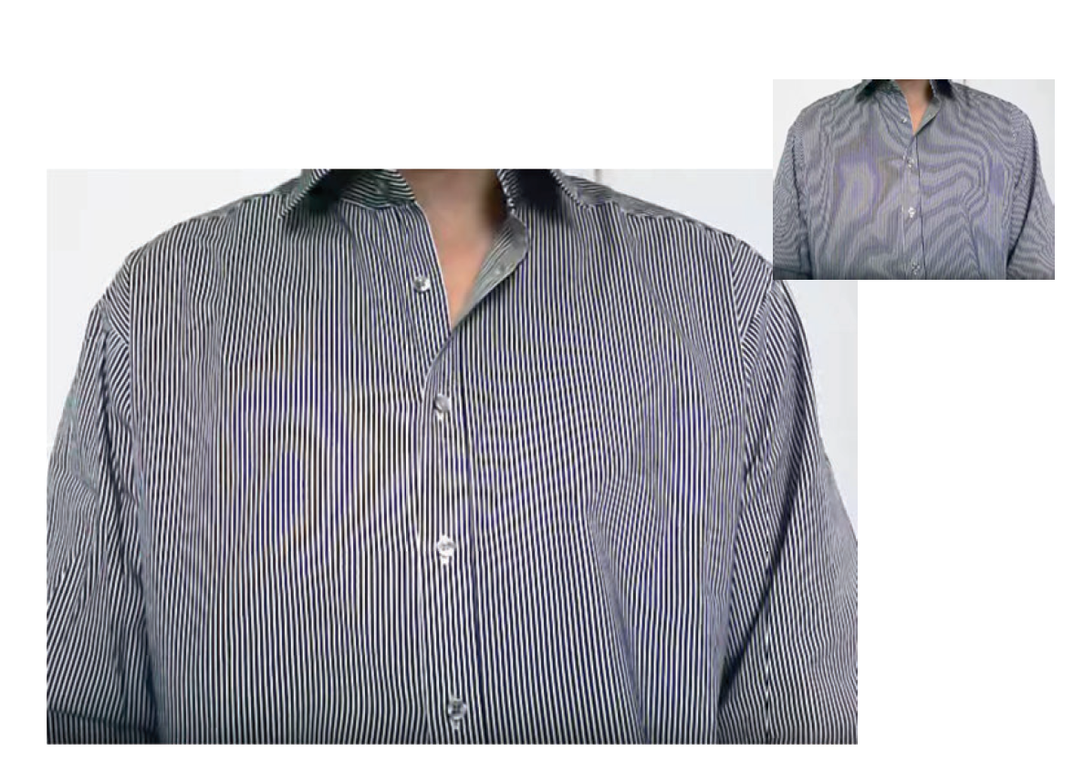

Slide 19
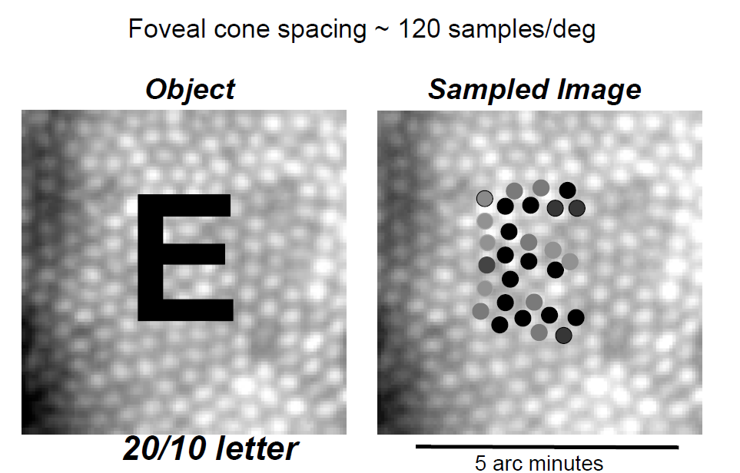
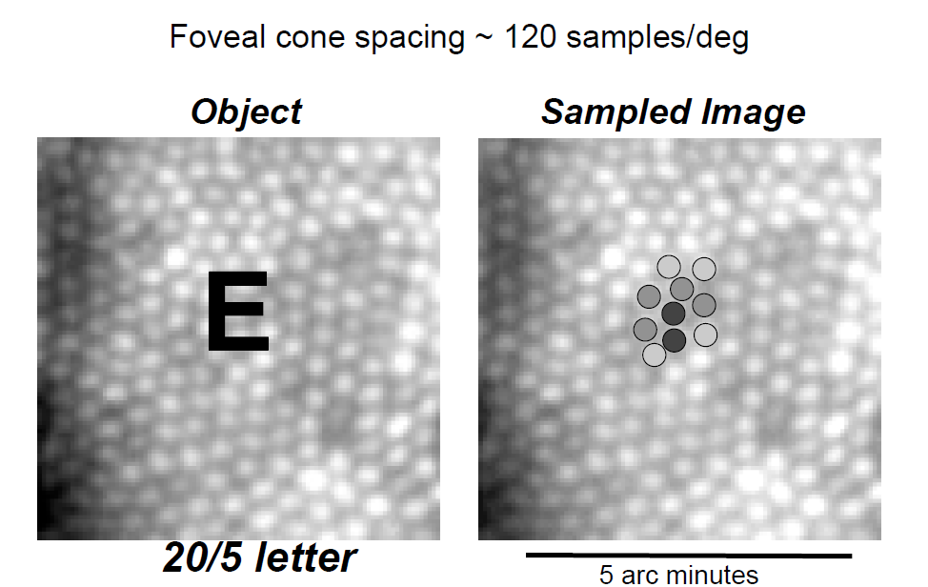
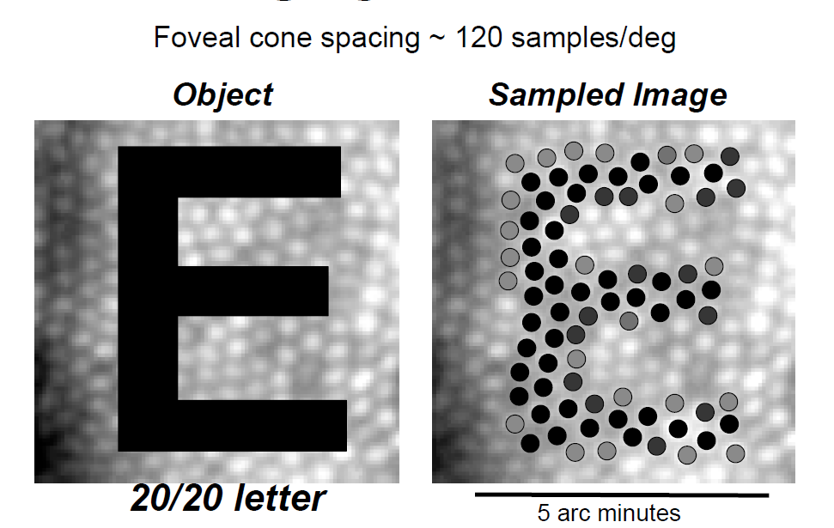

Slide 20
Calibration
ends of scale aren’t necessarily 0/15
curve isn’t necessarily linear
you have to build calibration curve
can be preflight design/engineering
can be in flight
both?

Slide 21
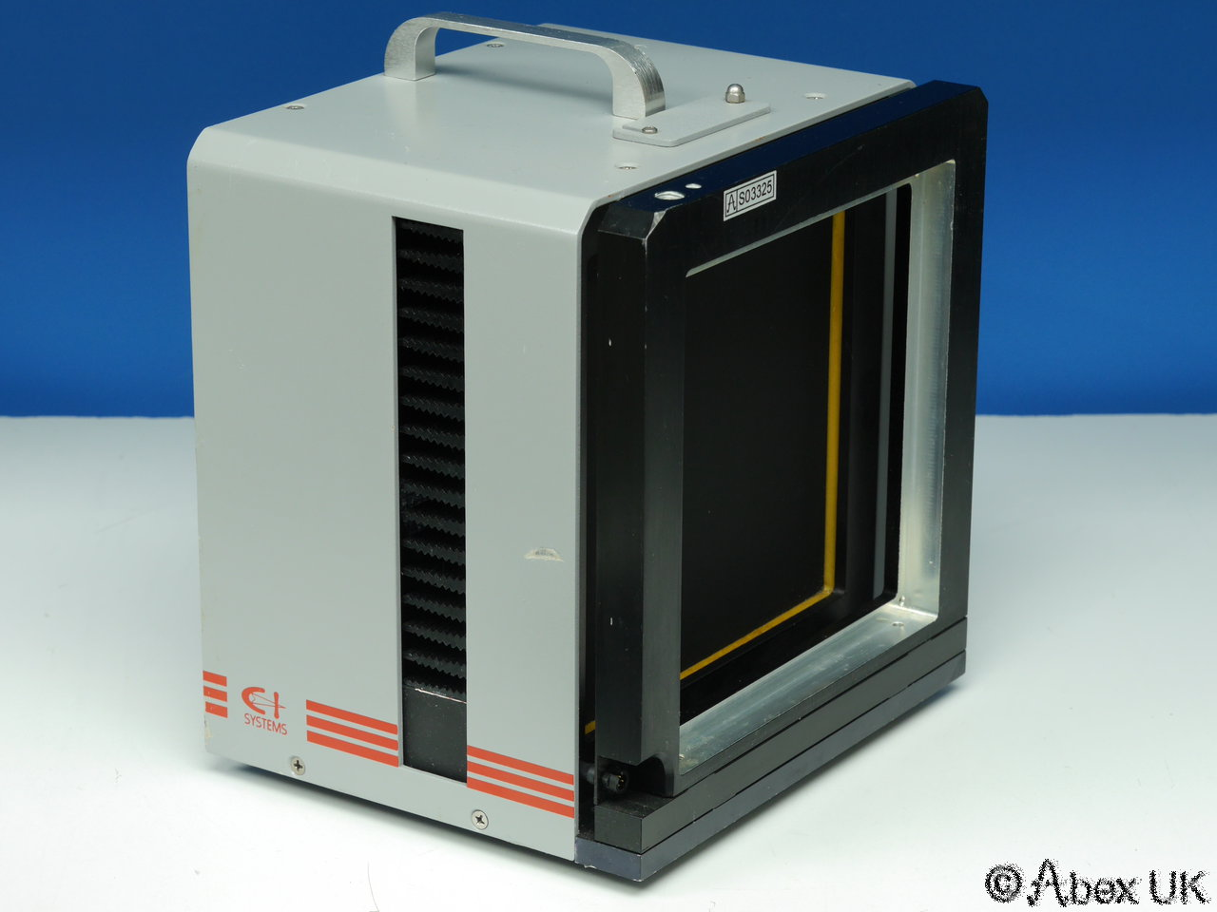
Thermal Calibration

Slide 22
